Slide 1
Frito lay employee case study
JAKE RASTBERGER

Slide 2
AGENDA
Introduction
Job Type Specific Findings
Attrition by Job Type and Time
Attrition Model
Salary Model
R Shiny Attrition Predictor
Summary

Slide 3

MEET OUR TEAM
JAKE RASTBERGER

Slide 4
Job Type Specific Findings

Slide 5
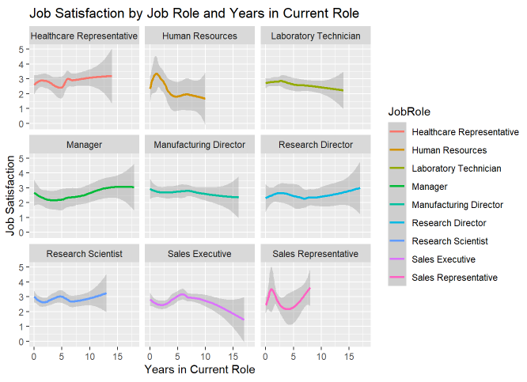
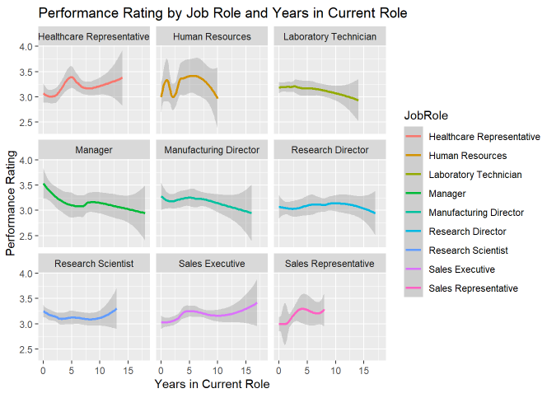
Job types
Clear bump for most roles at the start of their time in the role
Satisfaction and Performance both spike early on as you learn the role
As time goes on performance usually increases but job satisfaction usually drops off
Clear differences in job types
Long vs Sort term roles

Slide 6
Attrition by Job Type and Time

Slide 7
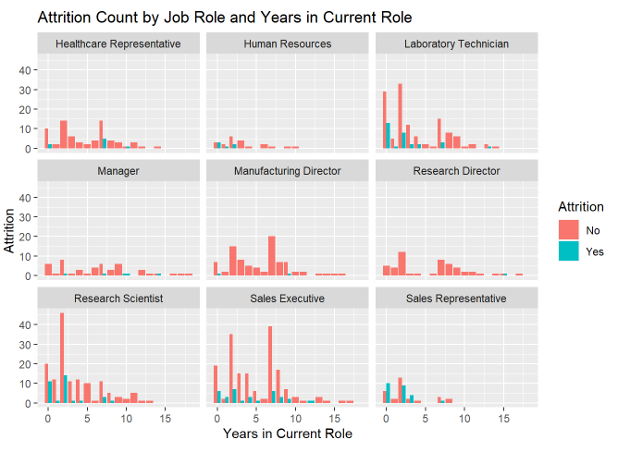
Attrition by role type
A trend sticks out to me that for “shorter” term roles a clear attrition pattern happens early on in role where an employee is much more likely to quit.

Slide 8
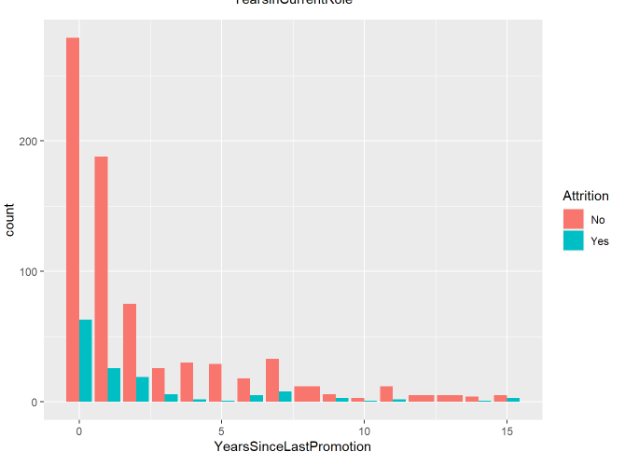
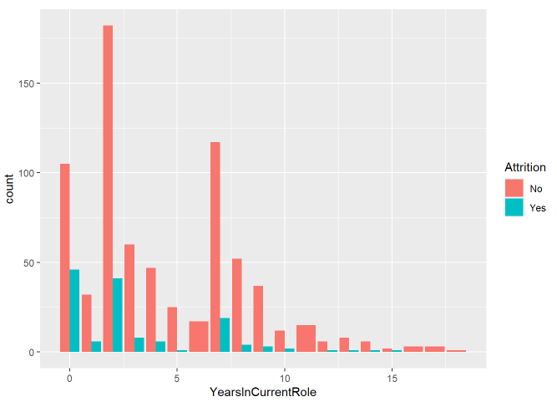
Attrition over time in role
Again, with aggregated data we can see a clear trend that early on in an employee's tenure in a new role they are much more likely to quit.

Slide 9
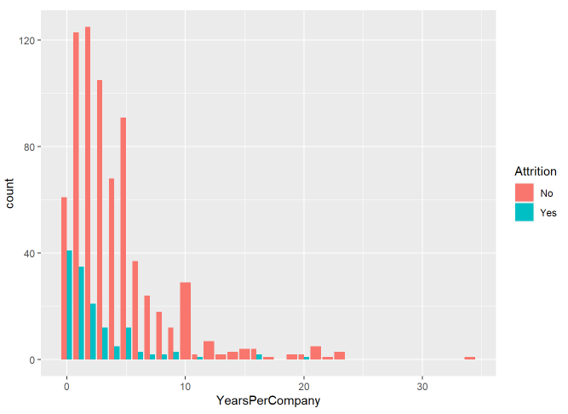
Attrition for “job hoppers”
Also, interesting is if an employee hops around from company to company (Total Working Years / Number of Companies Worked) they are more likely to quit

Slide 10
Attrition Model

Slide 11
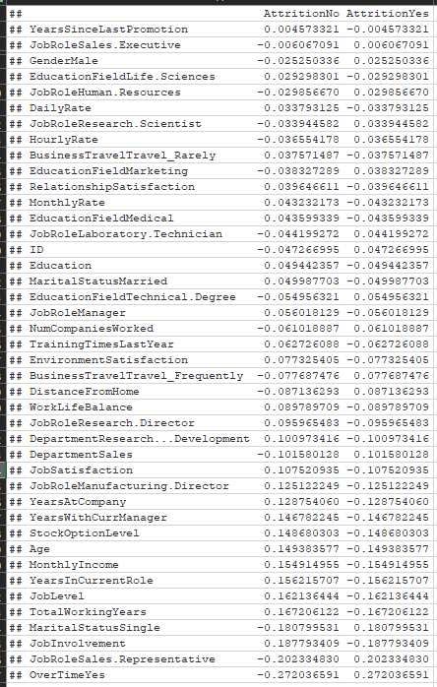
Correlation to attrition
To build this model the first thing we looked at was the correlation between each variable and attrition.

Slide 12
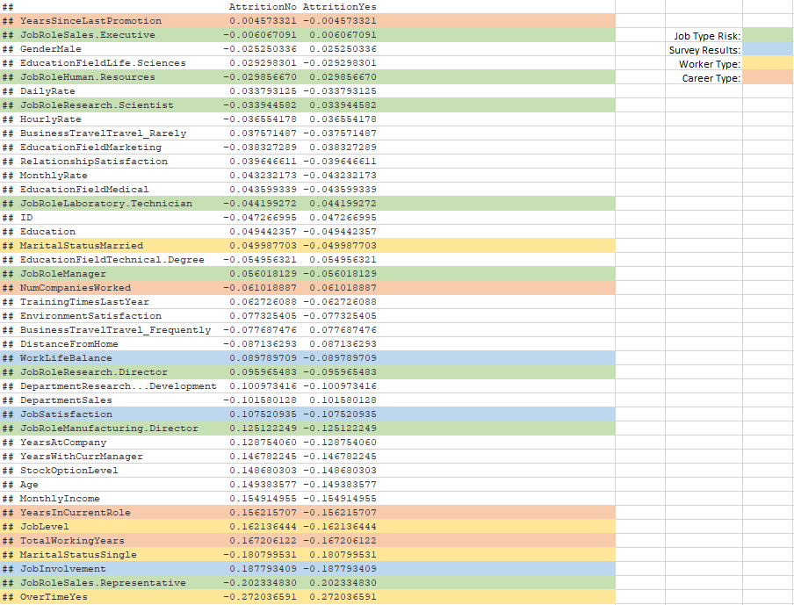
Correlation to attrition
Based on our earlier analysis we thought with some feature engineering we could achieve:
A more manageable list of variables
Variables that have more of a correlation with attrition

Slide 13
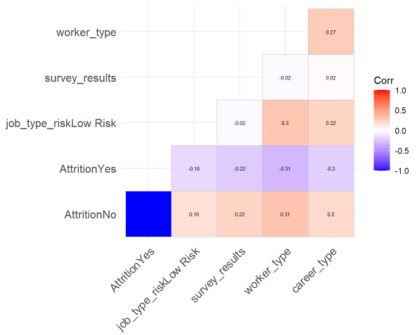
Feature engineering

Slide 14
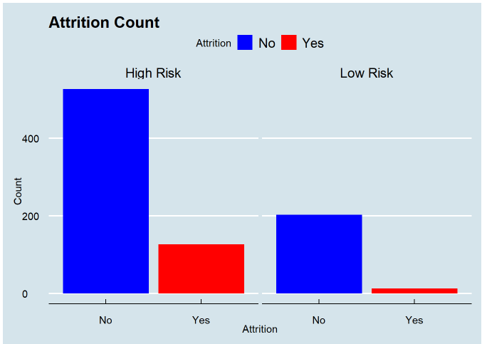
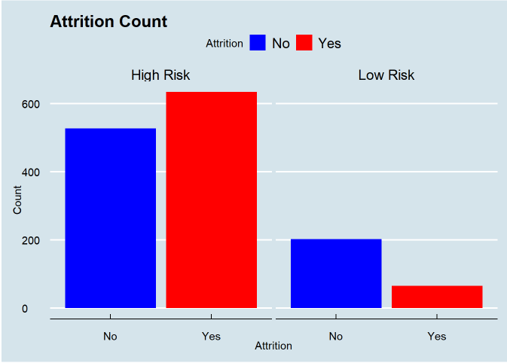
Data balancing
Before and after data balancing using SMOTE (Synthetic Minority Oversampling Technique).

Slide 15
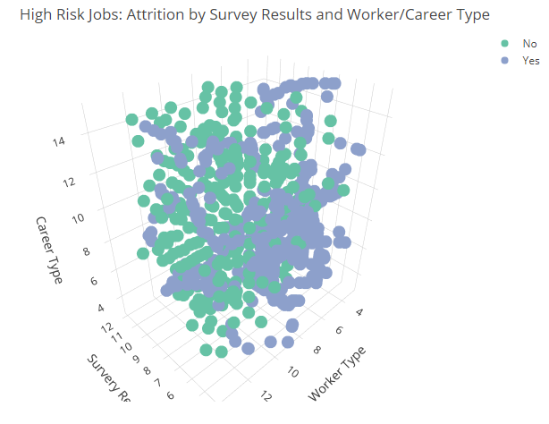
High risk attrition

Slide 16
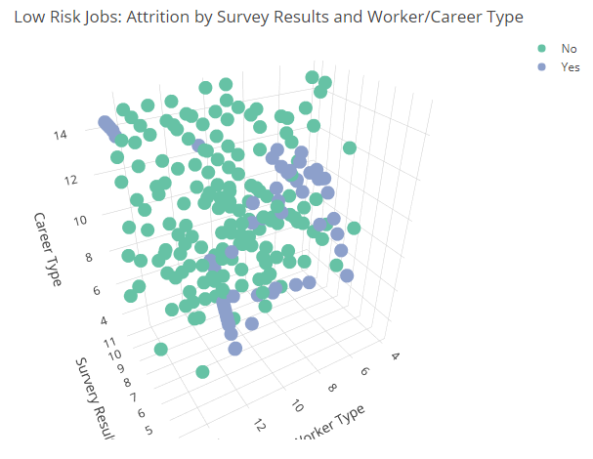
low risk attrition

Slide 17
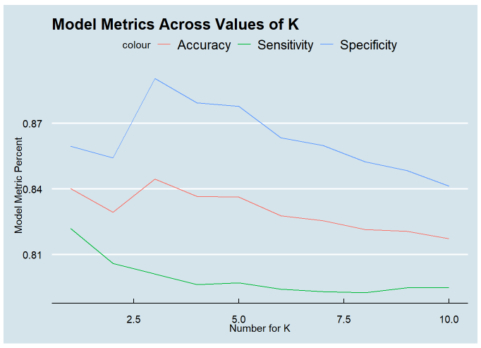
KNN Model set up
Clear winner with K = 3 for optimal model tuning.
Iterated 500 times for each value of K to find average metric percents

Slide 18
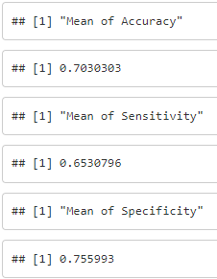
Naïve bayes setup
Not a lot of tuning for this model but running many iterations and capturing the average results we can see the model is not preforming as well on this data set as KNN so, we chose to use KNN over Naïve Bayes.

Slide 19
Salary Model

Slide 20
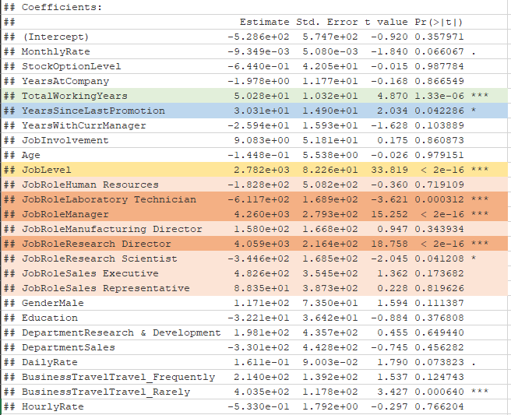
Coefficients importance
Running a linear model for all variables thought to be worth looking into for salary we can see the clear important variables.
One note is not all Job Roles seem to have a major impact.

Slide 21
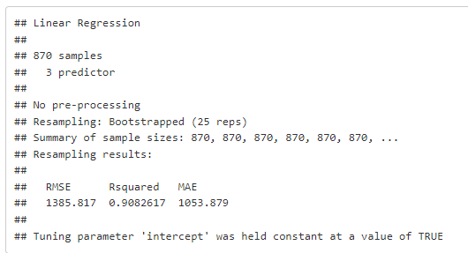
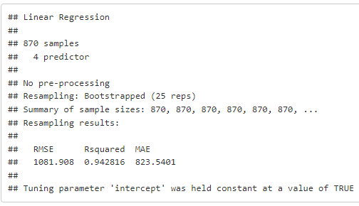

Test to include job role
Test with and without Job Role showing lower RMSE with job role included.
Without Job Role
With Job Role

Slide 22
R Shiny Attrition Predictor

Slide 23
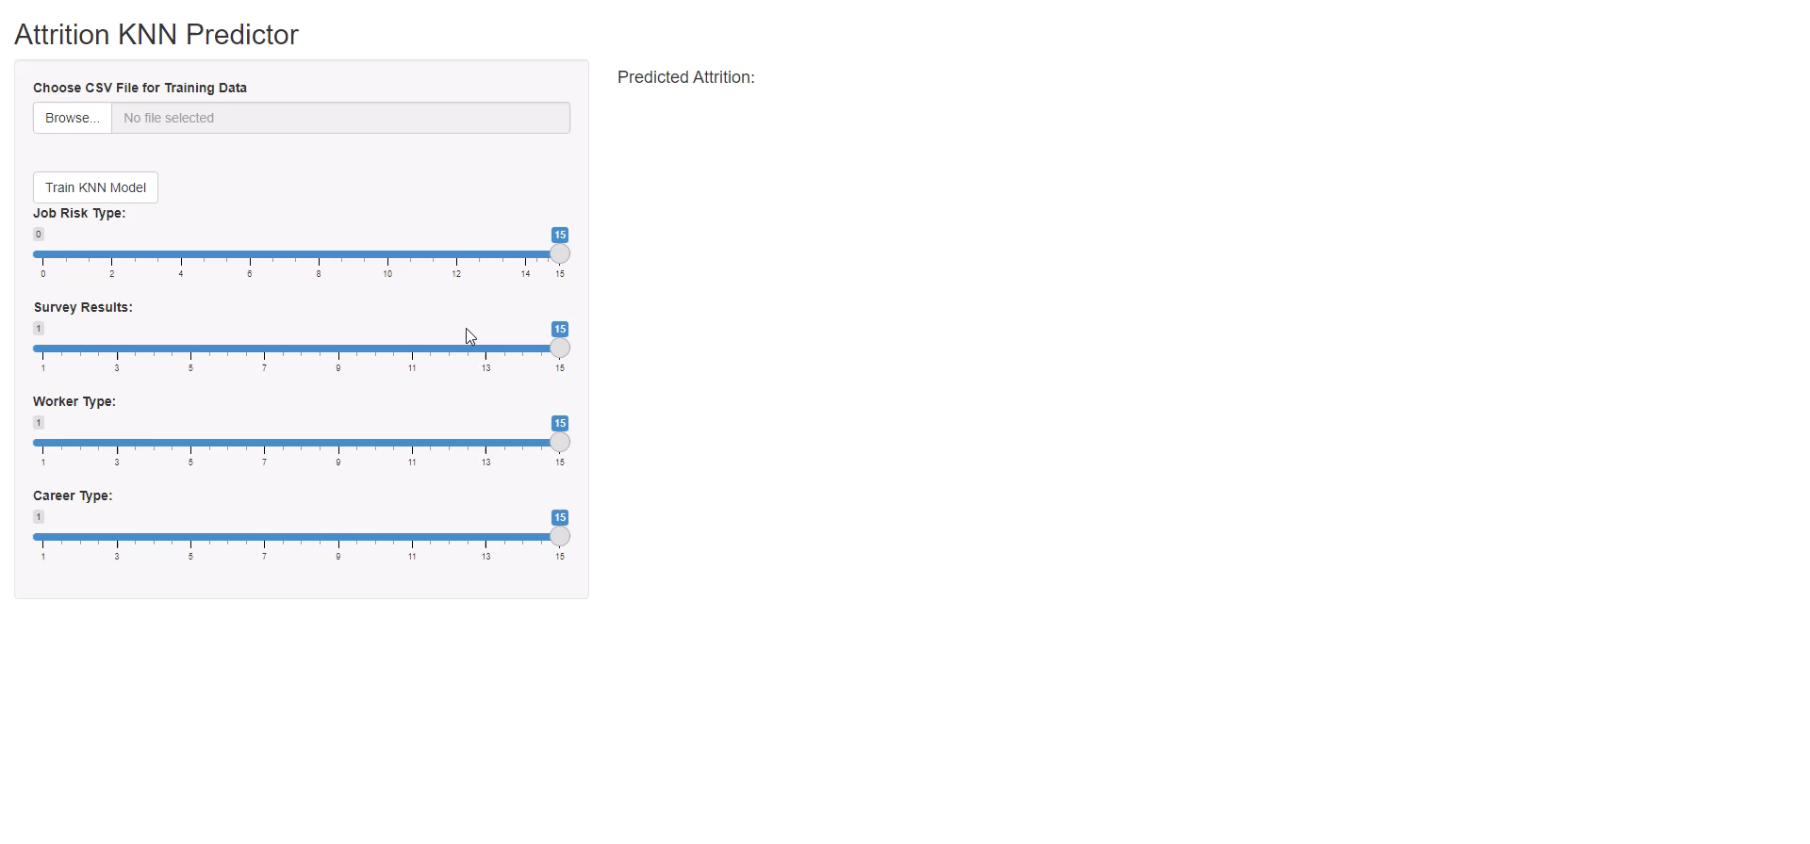
HR attrition app

Slide 24
SUMMARY
The evidence suggests some relationships between attrition and job types as well as time spent in a role.
We created both a KNN model for attrition as well as a linear model for predicting salary.
The KNN model is now deployed and can be used by HR or anyone else to predict attrition at the company based on whatever data is available

Slide 25
THANK YOU
Jake Rastberger – jrastberger@mail.smu.edu

